Slide 1
PDR Week 2
TeaM4C (R Dominick, L Gogley, M Munoz, D Tran)

Slide 2
Requirements
The design shall map unknown coordinates through exploration on passable terrain.
  Location of choice should not dictate mapping method, i.e. a room vs a field.
The design’s structural capture shall not be limited by low light settings.
  The scans must be accurate enough to recognize a low profile object as an obstacle/structure in its map.
The design shall be capable of 2D SLAM.
  SLAM shall be used to handle 2D coordinate recognition, and assist in 3D sampling.
The design shall be capable of 3D capture.
  3D capture can be pulled from samples or from real-time/soft real-time capture.
The design shall be powered from an independent power supply.
  This power source shall provide enough power to explore, at minimum, 20 minutes of capture.

Slide 3
Limitations
The design is not confined to low light, visible image capture.
  High resolution 3D structural capture is used to compensate for loss of visuals under low light.
The design is not confined to autonomous navigation, simply the capability of such.
  The design will be capable of mapping and localization, but the platform may not drive autonomously as functionality of mapping is the first priority.
The design is not confined to real-time 3D mapping, due to limitations of price and available algorithms.
  Real-time 3D is sometimes limited to ability of hardware readout, and may be an unrealistic endeavor. 3D may instead be done from sampling.
The design is not interested in object recognition.
  Point clouds will be used to simply display raw data, and points on a 2D plane will only be used to determine the explored area.

Slide 4
Systems Engineering

Slide 5
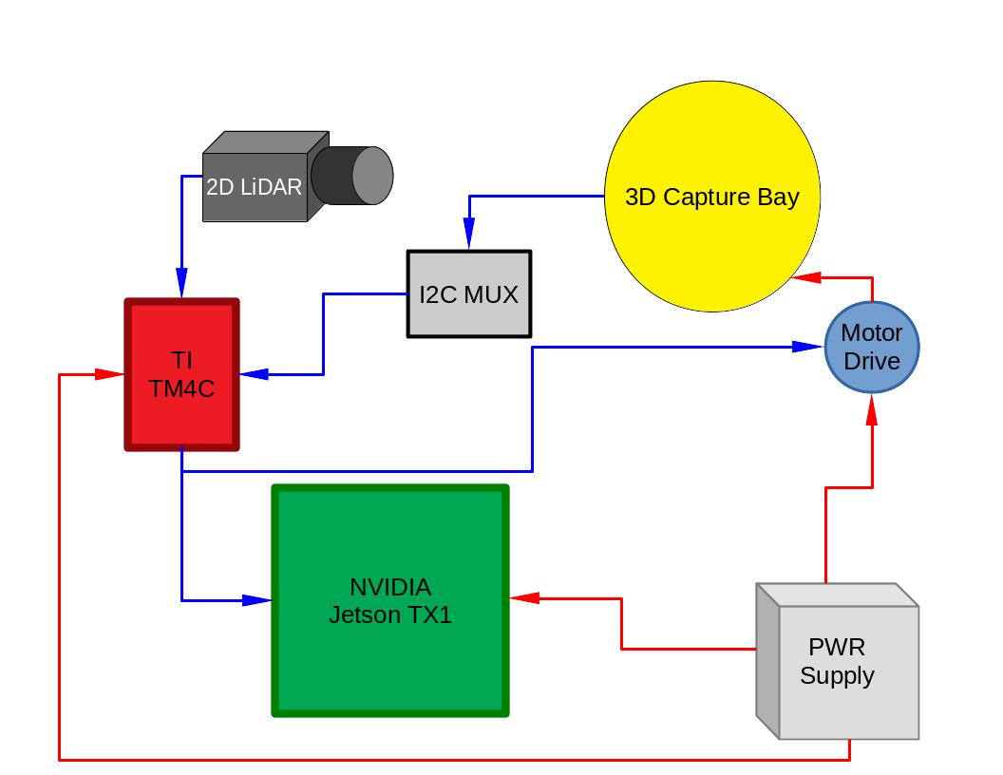
Top Level Block Diagram

Slide 6
3D Capture
LiDAR

Slide 7
Mechanical Engineering

Slide 8
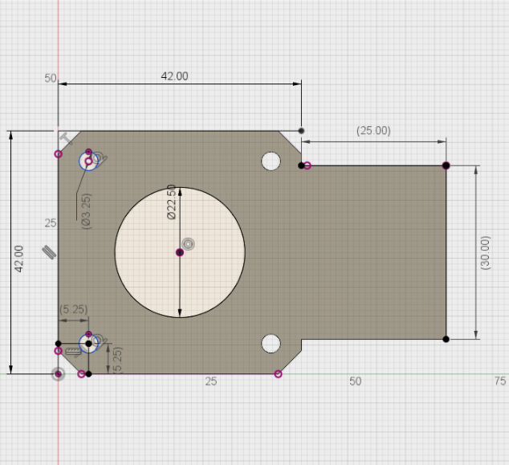
Top Level Motor Assembly
3D capture bay assembly, driven by stepper.

Slide 9
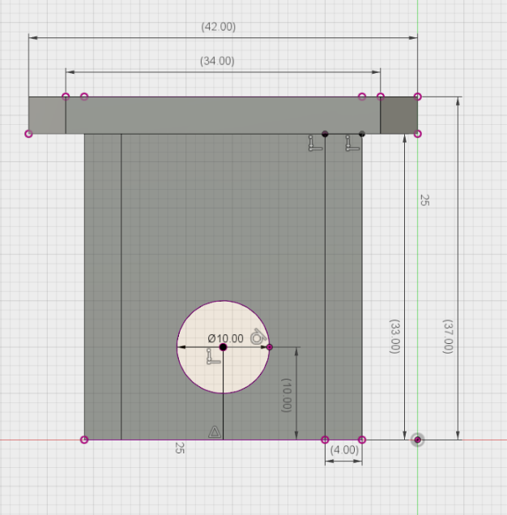
Motor Mount Assembly
Motor drive support assembly

Slide 10
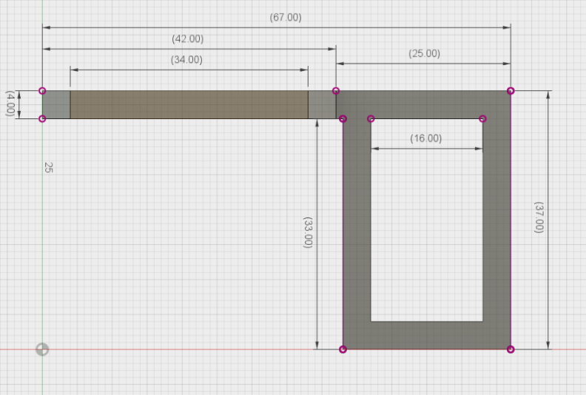
Motor Platter Assembly
Platter support assembly to 3D capture bay

